Slide 1
JOBSURANCE GJ PM 11 – Group E
Ankit Kumar
Priyesh P
Nishant Verma

Slide 2

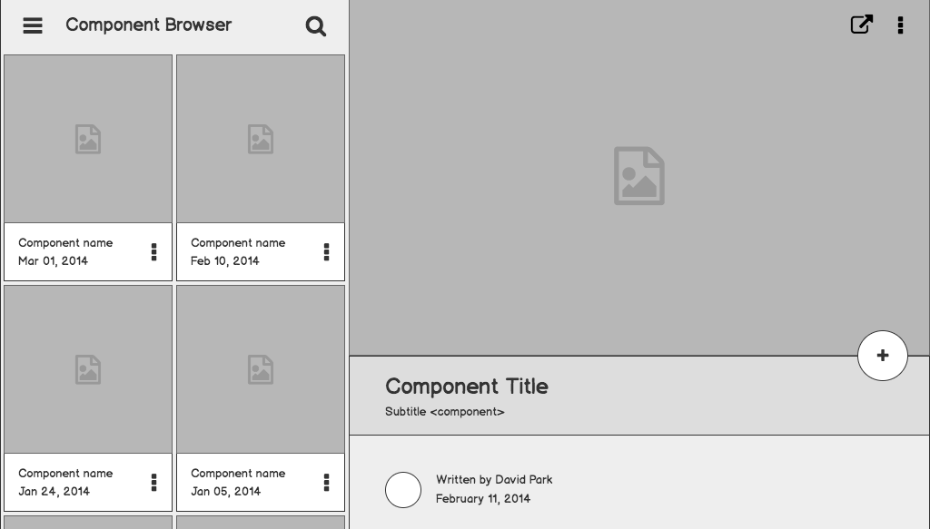


Jobsurance
Secure your future, even in uncertainty. Introducing JobSurance: Your safety net in the face of job loss, because your peace of mind is non-negotiable.

Slide 3
Outline
Market Overview
Growth Drivers
Current Situation
Market Potential
Features

Slide 4
India fastest among Fastest Growing Economy
India is projected to become 6th largest insurance market by 2032
Market Overview:

Slide 5
Indian Insurance premium volumes stands at $127 Bn as of 2021 Total increased by 13.5% in 2021 as against a global average of 9%
Market Overview:
Source: Ministry of corporate affairs

Slide 6
Favourable Demographics:- 68% of India’s population is young and 55% of its population is in the age group of 20-59 (working population) Wide middle-class expansion:- By 2030, India will add 140 Mn middle-income and 21 Mn high-income households which will drive the demand and growth of Indian insurance sector Digital behaviour patterns Pandemic-related shift in demand patterns Government Initiatives :- PMSBY, PM-JSY etc
Growth Drivers

Slide 7
JLI market in India is still in its infancy. Growing demand for JLI products, as the Indian economy becomes increasingly competitive and job displacement becomes more common.
Current Situation
JLI market in India is fragmented, with no single dominant provider. There are a number of potential providers of JLI

Slide 8
ICICI Lombard Unemployment Insurance HDFC ERGO Loss of Job Insurance Reliance General Insurance Baj a j Allianz Individual Personal Accident
Top Job Loss Insurance Providers in India

Slide 9
India's growing economy and expanding workforce present a substantial market potential for job loss insurance. The Indian workforce is estimated to reach 600 million by 2030, and the country's unemployment rate has been hovering around 6%. With increasing automation and technological advancements, the risk of job loss is likely to persist. Job loss insurance can play a crucial role in mitigating the financial impact of unemployment and ensuring social security for a large segment of the Indian population
Market Potential

Slide 10
Features
Coverage Period
Eligibility Criteria
Types of Job Loss Covered
Duration of Benefits
Exclusions:Job Search Assistance
Claim Process

Slide 11
Communication
Product Vision
To become the world's leading provider of income protection insurance
Enabling individuals and families to confront financial challenges with assurance
Value Proposition
In case of involuntary terminations arising from employers discretion, you will be provided with financial support
Termination reasons could be,
Economic cycles
Employer's need to restructure itself
Employer itself going out of business
Change in function of the Employer
Product or service is no longer offered by the employer
Surplus of labor
Mergers and Acquisitions

Slide 12
Financial Service Industry Architecture
USERS
CLOUD
ENTERPRISE
External Data
P
viders and
r
E
o
tners
Analytical Insights
c
o
sy
s
t
em
P
a
r
CU
OMER EXPERIENCE
A
IFICIAL INTELLIGENCE
A AND AI
A SOU
CES & AP
S
R
T
T
R
I
D
s
AT
D
PEER C
OUD
AT
E
TEM
L
TNERS
C
O
S
Y
S
P
A
R
CU
OMER
S
D
KN
WLEDGE
SON
T
TRANSACTION
AT
A
O
W
A
A
ANT
DIS
VE
THER
T
S
SI
S
T
C
O
R
Y
WE
A
VIS
U
UI
OMMUNI
IONS
AL
C
C
A
T
UI
AT
DATA
VI
ALIZ
ION
TUDIO
D
A
R
T
U
A
T
C
AT
A
L
SE
VICES
OG
S
R
INSIGH
T
L
S
O
F
W
MIC
SE
VICES
R
FI
CRED
O
R
C
O
I
DEMOGRAPHICS
T
ORRESPONDENCE
B
OC
CHAIN
C
ME
CHAN
L
K
R
T
S
ANK
NE
ORK
B
T
W
OPER
IONAL
DOCUMENT
A
T
REP
D
AT
A
O
S
I
T
O
R
Y
Digital Agility Services
BUSINE
S MIC
SE
VICES
S
R
O
R
T
aditional and New
r
24 h
Banking Channels
C
TERAL
TER OF
OL
L
ORPOR
A
LE
CU
OMER
C
A
CU
OMER
T
TE
S
S
T
T
P
A
R
T
Y
D
AT
API
AN
CRED
A
OFFER
ENTERPRISE
I
L
SE
VICE
T
O
R
MAN
GEMENT
A
TRANS
ORM
ION
F
A
MAN
GEMENT
T
A
GREEMENT
USER
A
&
ONNEC
T
IV
I
T
C
Y
DIREC
T
O
R
CU
OMER
Y
T
S
Ana
ytical Insights
INTELLIGENT
ANKING
l
W
ORKF
B
L
O
WS
OGN
IVE SOx
IONS
C
IT
L
U
ANK
T
B
TELLER
EDGE
INSURERS U
T
ORK
ADS
IL
I
T
Y
W
L
SE
VICES
$
!
O
R
D
AKE
AT
A
L
SUPPO
R
ING APPLI
IONS
T
C
A
TRADE
L
AN
T
O
SON
M
CHINE
UD
REAL-TIME
A
FR
W
A
A
T
BUSINE
S
FINANCE
ORIGIN
ION
S
A
T
OPENS
ALE
LEARNING
DETEC
ION
INSIGHTS
C
T
ULES
RE
IONSHIP
R
L
A
T
G
R
MAN
GER
C
$
A
HADOOP
OBJECT
D
CU
OMER
AT
A
S
T
MARKE
ING
CC
T
FINANCE
A
OUN
ING
STORE
AREHOUSE
RE
IONSHIP
T
W
L
A
EN
TRANS
ION
AML RISK
C DUE
T
Y
TI
TRANS
ION
K
T
Y
A
C
T
A
C
ACCOUNT
ACCOUNT
T
ORE APPLI
IONS
C
C
A
ANA
ICS
MON
ORING
MODELS
T SCREENING
DILIGENCE
T
L
Y
T
I
T
LI
C
S
ALL
SERVICING
OPENING
OR AML
CENTER
F
$
L
AN
ORE
MO
GE
O
C
R
T
G
A
ANKING
INTERNET
OMPLIANCE
ACCOUNT
B
ANKING
C
B
SALES
VENT
E
TREAMS
Busine
s
S
s
ORPOR
GENERAL
P
YMENTS
C
A
A
Au
t
TE
om
a
tion
ANKING
LEDGER
HYBRID C
OUD
B
RE
AIL
L
T
ANKING
B
Co
e S
ems and S
r
y
s
t
y
s
t
em
o
f
R
e
c
o
r
RED H
VM
ARE
MU
I C
OUD
ds
L
A
T
L
T
W
MAN
GEMENT
ON
CTLE
OPENSHIFT
A
C
T
A
S
ANKING
S
B
Secured, Compliant Cloud Infrastructure
LEGEND
Users
Application
Data orien
t
ed se
r
vi
c
Dis
c
e
ov
e
r
y se
r
vi
c
A
es
TM
Ana
ytics
SECUR
UTHEN
ION
l
A
T
I
C
A
I
T
T
ENC
YP
ION
UTHORIZ
ION
Y
R
T
A
A
T
IBM C
OUD
L
IN
ORM
ION
Security
F
A
FRAME
ORK
OR
T
W
F
&
VENT
FINANCIAL SE
VICES
E
R
Mana
ement
MAN
GEMENT
g
A
Bloc
k
chain

Slide 13
Nonfunctional requirements
Security
All application systems must implement robust controls over their communication network for Safeguarding data, Tightly controlling access to network devices through management approval and subsequent audits , Logging and monitoring remote access etc.
2) Scalability
The architecture must be able to support large-scale deployments.
3) Availability
Financial institutions need to operate in a 24 x 7 environment. The infrastructure must be available to the customers whenever they want, wherever they are, and on whatever channel they prefer to interact.
4) Backup and offsite storage
All application systems must have a defined backup policy and associated procedures for backing up data in a scheduled and timely manner.

Slide 14
Pricing
PRO
100% Of current salary per month for 3 months
@ Salary 50K per month – 1999 Rs annually
@ Salary 2 L – 10 L per month - 6499 annually with coverage up to 2 L
PLUS
75% Of current salary per month for 3 months
@ Salary 25K per month – 1000 Rs annually
@ Salary 2 L – 10 L per month - 4999 annually with coverage up to 2 L
Services provided
Coaching to ace job interviews and maximize your benefit period success.
Coaching to ace job interviews and maximize your benefit period success.
Impress potential employers with a solid professional profile and resume during the benefit period.
An assigned job search professional to provide personalized support.
Use a chosen network of placement specialists to boost your career.

Slide 15
Product Launch
Partner Development
Select Pilot Participants & Iterative Testing and Improvement
Limited Public Release &
Relationship strengthening
Full-Scale Marketing Campaign
Phase 1
Phase 2
Phase 3
Phase 4

Slide 16
Thank You! Questions?

